Slide 1
The Quality Imperative for CVEs
The Need For Enhancing Vulnerability Reporting Standards VulnCon2025 April 8th, 2025
Notes:
This presentation was automatically generated by PowerPoint Copilot based on content found in this document: https://cisco-my.sharepoint.com/personal/gamblin_cisco_com/_layouts/15/Doc.aspx?sourcedoc=%7BA8899202-D08F-4BCD-8427-6DE1F6779A23%7D&file=The%20Quality%20Imperative%20for%20CVEs.docx&action=default&mobileredirect=true&DefaultItemOpen=1 AI-generated content may be incorrect.

Slide 2
About This Talk
The purpose of this presentation is to initiate an open dialogue regarding the overall quality of CVEs. I do not intend to target or embarrass any specific CNA or organization. My work often depends on CVE data, and this talk aims to identify areas where the community as a whole can enhance its efforts. I encourage anyone interested in this process to think about joining the CVE Program's Quality Working Group, where we conduct thorough analyses of the data on a weekly basis.

Slide 3
About Me
Jerry Gamblin
Principal Engineer Cisco TD&R
gambling@cisco.com
@jgamblin (X/Etc)
jerrygamblin.com
cve.icu

Slide 4
Agenda
Current Challenges in CVE Reporting
Proposed Enhancements to CVE Data Quality
Stakeholder Collaboration
Notes:
Agenda * Introduction * Overview of CVEs * Importance of CVEs * Purpose of the Talk * Current Challenges in CVE Reporting * Data Quality Challenges * Consequences of Poor Reporting * Global Implications * Need for Standardization * Proposed Enhancements to CVE Data Quality * Stricter Guidelines * Stakeholder Collaboration * Advanced Validation Processes * Role of Technology in Enhancing CVE Quality * Automation in Quality Assurance * Technological Tools * Ongoing Education and Training * Continuous Learning Strategies * Conclusion

Slide 5
Current Challenges in CVE Data
Data Quality
Schema variations from CVE & NVD
Data completeness varies by CNA
Incomplete or Inaccurate Information
Minimal required fields
Minimal Data Provided
Data Issues
Source Of Truth
Ease of Bulk Data Access
Notes:
Data quality issues include inconsistencies and incomplete or inaccurate information. These problems can arise from non-uniform data, missing data points, and errors in data entry. Original Content: · Inconsistencies in data quality · Incomplete or inaccurate information

Slide 6
Incomplete or Inaccurate Information

Slide 7
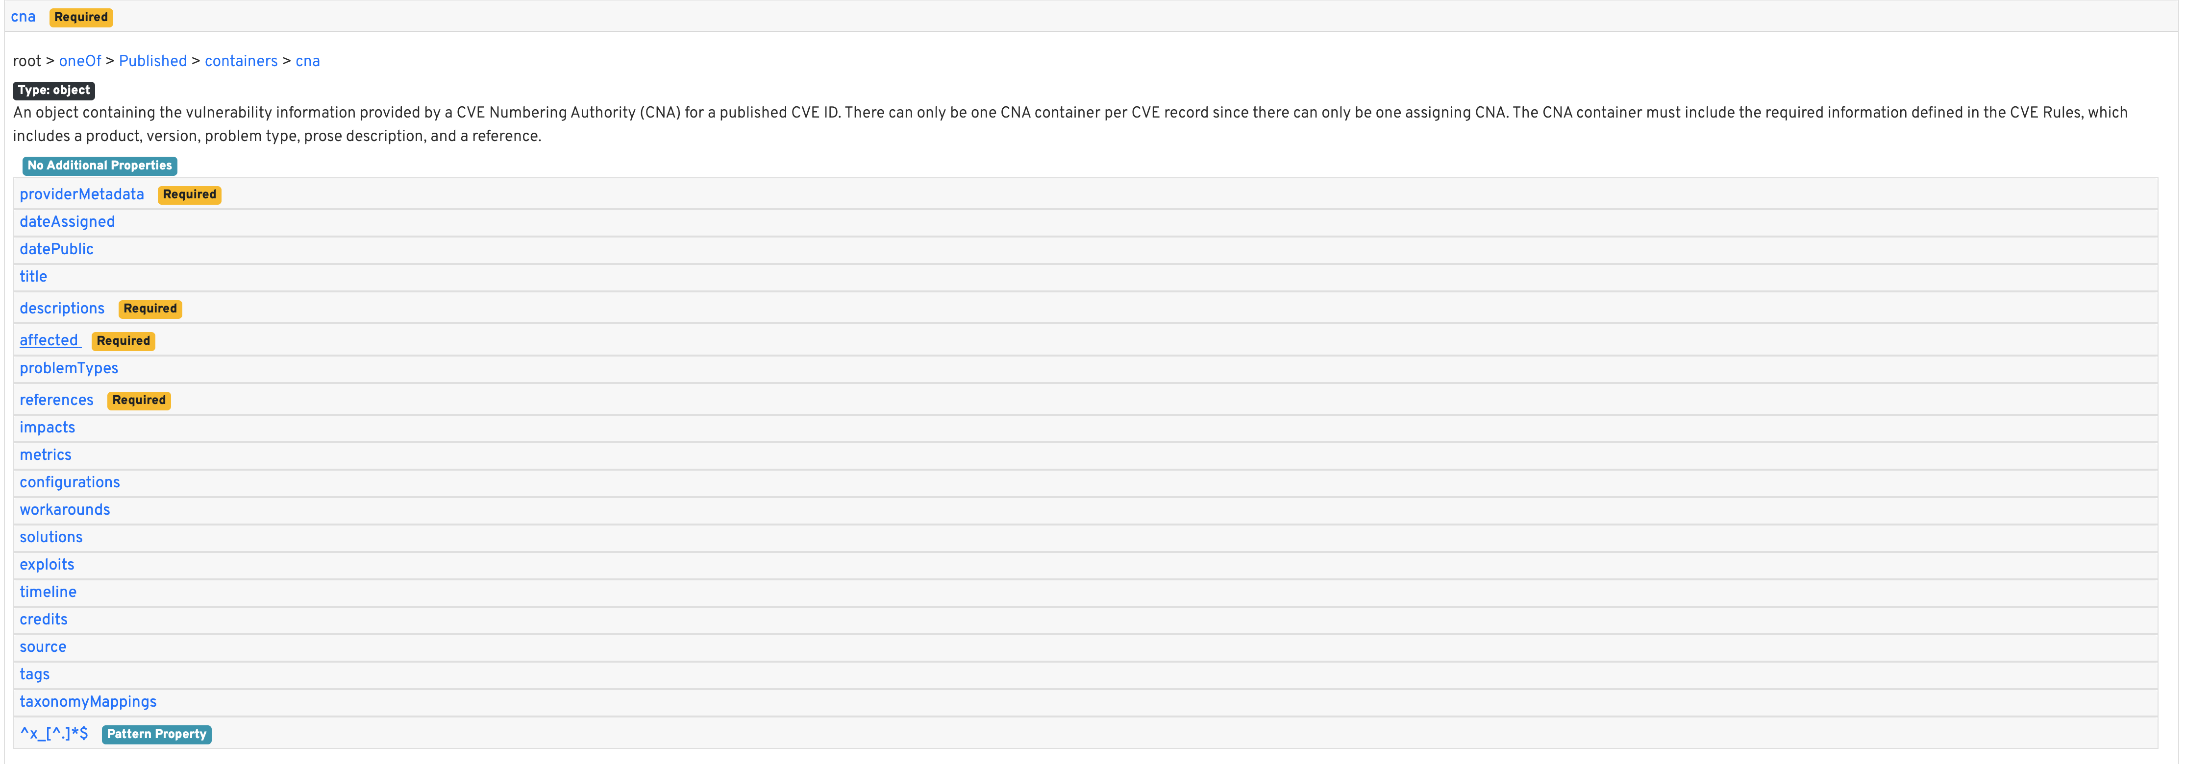
Minimal Required Fields

Slide 8
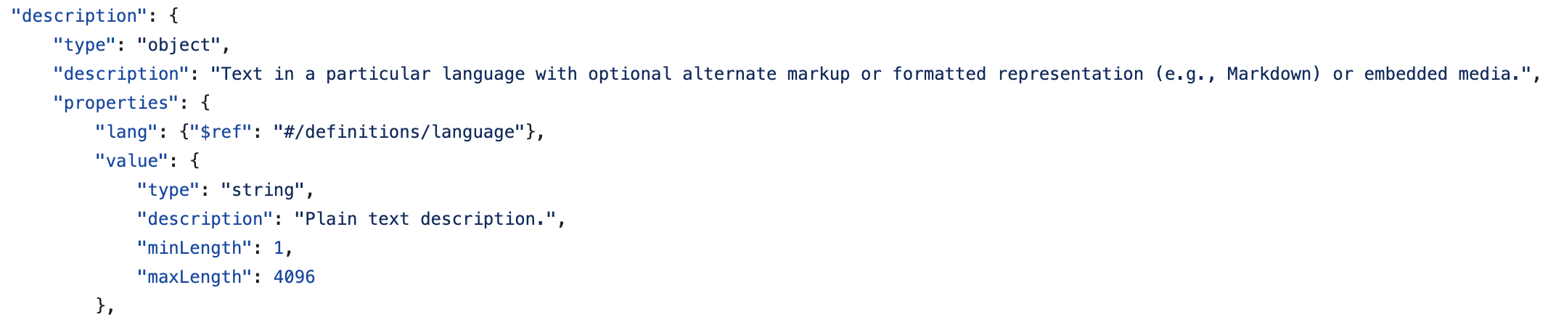
Minimal Required Fields

Slide 9
Minimal Data Provided
CVE | Description | Description Length
CVE-2022-42539 | Information disclosure | 2
CVE-2023-28228 | Windows Spoofing Vulnerability | 3
CVE-2022-34716 | .NET Spoofing Vulnerability | 3
CVE-2020-1599 | Windows Spoofing Vulnerability | 3
CVE-2022-42536 | Remote code execution | 3
CVE-2023-5914 | Cross-site scripting (XSS) | 3
CVE-2022-42538 | Elevation of privilege | 3
CVE-2022-42540 | Elevation of privilege | 3
CVE-2022-42541 | Remote code execution | 3
CVE-1999-0165 | NFS cache poisoning. | 3
CVE-2025-21314 | Windows SmartScreen Spoofing Vulnerability | 4

Slide 10
Data Quality

Slide 11
Schema Variations From CVE & NVD
CVE Schema
60% have Key Descriptions
50% have Key Type
10 fields must match a regex pattern
9 keys required
NVD Schema
3% have Key Descriptions
100% have Key Type
2 fields must match a regex pattern
1 key required (CVE)
143 Keys
262 Keys

Slide 12
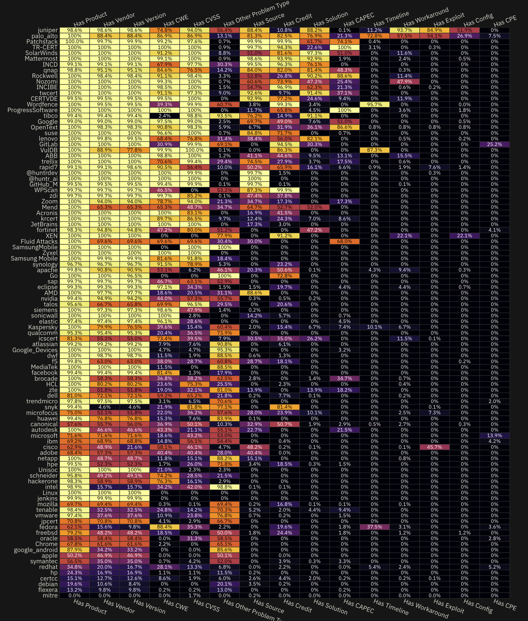
Data Completeness
Dr. Benjamin Edwards is a principal research scientist working at Bitsight measured CNA performance last year and produced this great resource to break down data completeness and quality.
https://bjedwards.observablehq.cloud/measuring-cna-performance

Slide 13
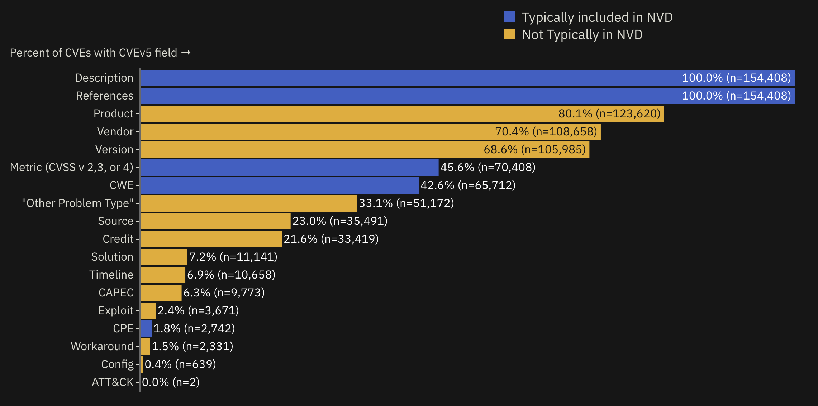
Data Completeness
https://bjedwards.observablehq.cloud/measuring-cna-performance

Slide 14
Data Issues

Slide 15
Source Of Truth For CVE Data?
What is the Source Of Truth For CVE Data?
Should the CVE or NVD be the Source of Truth?
What should be considered CVE Data?
The 3 mandated CVE fields?
Is CVSS, CWE, CPE and other data points CVE Data?

Slide 16
Ease of Bulk Data Access
CVE Program
Primary Raw Data Access Via GitHub Repo
No Public API
Limited Public Usage
NVD Program
Recent API stability issues.
Bulk Download (v1.1) and API (v2.0) Schema Mismatch.

Slide 17
Proposed Enhancements

Slide 18
Enhanced Publication Requirements
More Mandatory Fields
CVSS V4
CPE
CWE
Other?
Plain or Markdown Advisories
Easy For The CVE Program To Store and Display
End Link ROT.
Notes:
The presentation covers stricter guidelines for CVE submissions, aiming to ensure accuracy and improve security measures. It also emphasizes the importance of collaboration among stakeholders to enhance communication and share resources. Original Content: · Stricter guidelines for CVE submissions · Collaboration among stakeholders

Slide 19
Standardized Tooling
CVE Program Should Build and Maintain Tooling
GUI Based
CLI Based
Popular SDK (Go, Python, Etc)
CVE Program Should Invest in AI Tooling
Auto Suggest Unpopulated Fields
Notes:
We have established clear criteria for submissions to ensure consistency and quality. Additionally, mandatory verification processes are in place to guarantee the authenticity and accuracy of all submitted information. Original Content: · Clear criteria for submissions · Mandatory verification processes

Slide 20
Quality Validation Processes
All CVEs should pass a well documented and maintained quality validation test before automated publication.
Notes:
Automated validation tools help in checking data accuracy and quality efficiently. Peer review systems involve collaborative evaluation to ensure reliability. Original Content: · Automated validation tools · Peer review systems

Slide 21
Stakeholder Collaboration

Slide 22
Open-Source Leadership
Embrace Open Source
Establish an Open-Source Working Group.
Establish an Open-Source Office.
CNA Tooling
Formalize Support For Existing Tools
Data Consumers
Hackathons
Kaggle Competitions

Slide 23
Communication
Offer Official Communication Channels
Slack
Discord
Increase Community Involvement
RSA Week
Blackhat Week

Slide 24
Education & Training
Workshops and Seminars
CNA Seminars
Public Workshops
Certifications
CNA
Data Users
Vulnerability Data Consumers
Notes:
Education is essential for managing the CVE lifecycle, aiding in vulnerability identification and mitigation. Continuous learning strategies include regular training, workshops, and online courses. Original Content: · Importance of education for CVE lifecycle · Strategies for continuous learning

Slide 25
Standardized Reporting
Automated Monthly Public Quarterly Reports
CVE Wide Program Statistics
CNA Reports Statistics
Benefits of Standardized Reporting
Encourages data quality.
Provides standardized statistics.

Slide 26
Thank You
Jerry Gamblin
gambling@cisco.com
@jgamblin (X/Etc)
cve.icu

